Slide 1
Exponential Distribution
Egor Howell

Slide 2

What is it?
“In a nutshell, the Exponential Distribution infers the probability of the waiting time between events”
For example, the waiting time until someone makes an insurance claim.

Slide 3
Origins
To really understand the Exponential Distribution we need to start with the Poisson Process. The Poisson process is used to describe a counting process where the events happen at random but at a given rate.
For example, referring back to the insurance claims scenario, we know we have 5 claims per hour but those claims occur randomly within that time frame. They can be evenly spaced or all in the last minute.

Slide 4
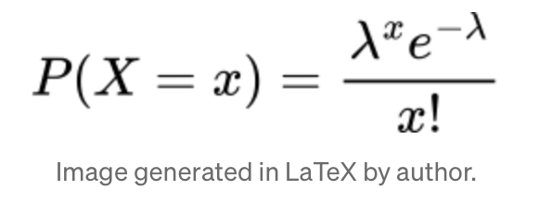

Poisson Distribution
The Poisson Process is characterised by the Poisson Distribution which has the Probability Mass Function (PMF):
Expected number of events
Number of events occurring

Slide 5

Poisson Distribution Example
Going pack to our claims analogy, we have a time period of 1 hour with around 5 expected claims to occur in that time period.
What is the probability of there being 1 claim?
Very small

Slide 6
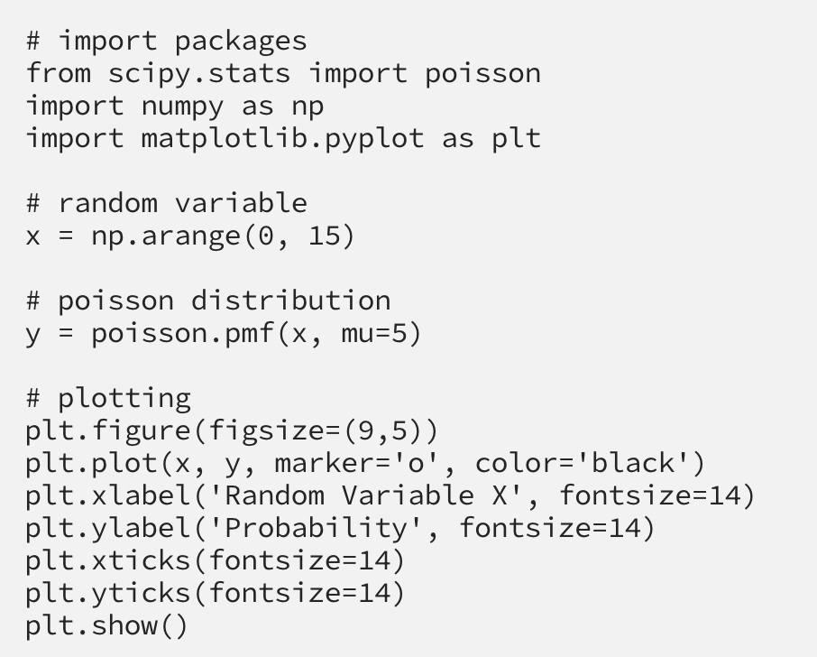
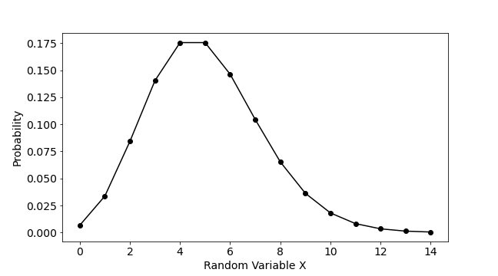
Poisson Distribution PMF
Most likely is 5

Slide 7
What’s The Link?
Well the Exponential Distribution describes the probability of waiting times between these events for Poisson Distribution.

Slide 8
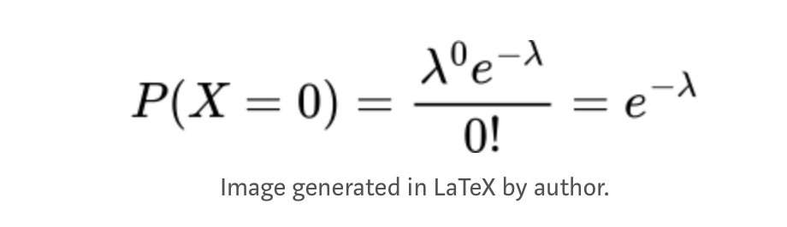
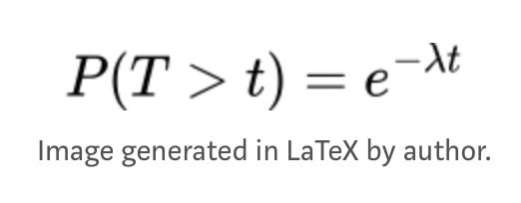
Derivation
The Exponential Distribution tells us the probability of waiting times between events. This means that for the given time period no events have occurred:
Now this is just for one time period, however we generalise this to t time periods. Therefore, we have to wait T time periods to get the first event:
We are saying that we have to wait t time periods (in our claims analogy this is t hours) until the first event (claim) occurs.

Slide 9
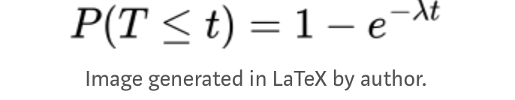
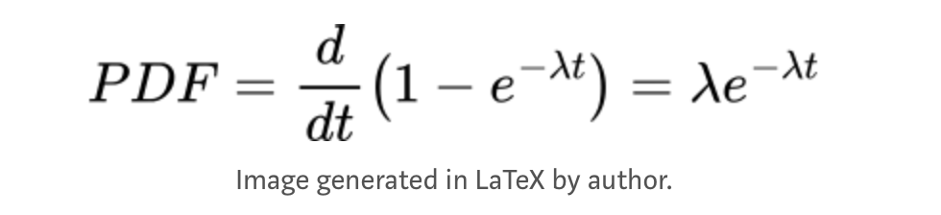
Derivation
On the other hand, the probability that an event does occur is:
This is also the definition of the Cumulative Distribution Function (CDF).
The derivative of the CDF is the Probability Density Function (PDF).
Exponential Distribution!

Slide 10
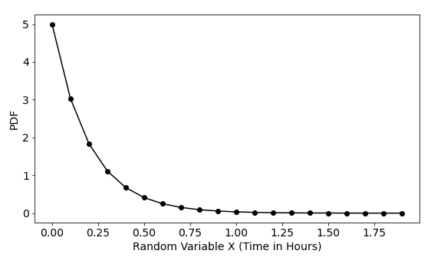
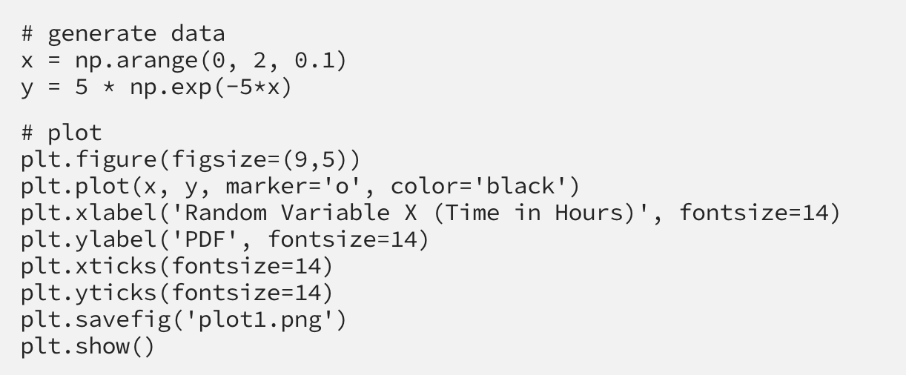
Example Plot
We have an average rate of 5 claims per hour, equal to an average waiting time of 12 minutes between claims:

Slide 11
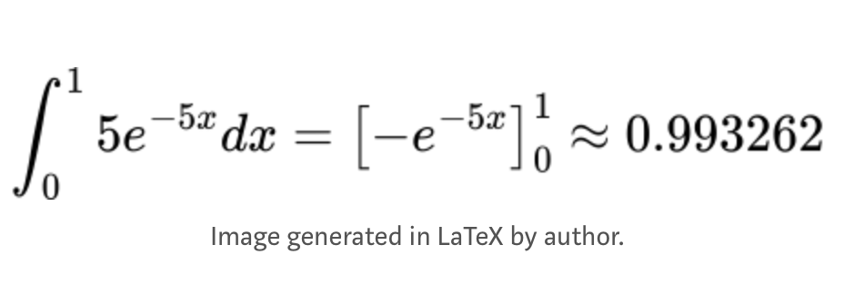
Example Plot
We have an average rate of 5 claims per hour, equal to an average waiting time of 12 minutes between claims:
What is the probability that the first claim occurs within the first hour?

Slide 12
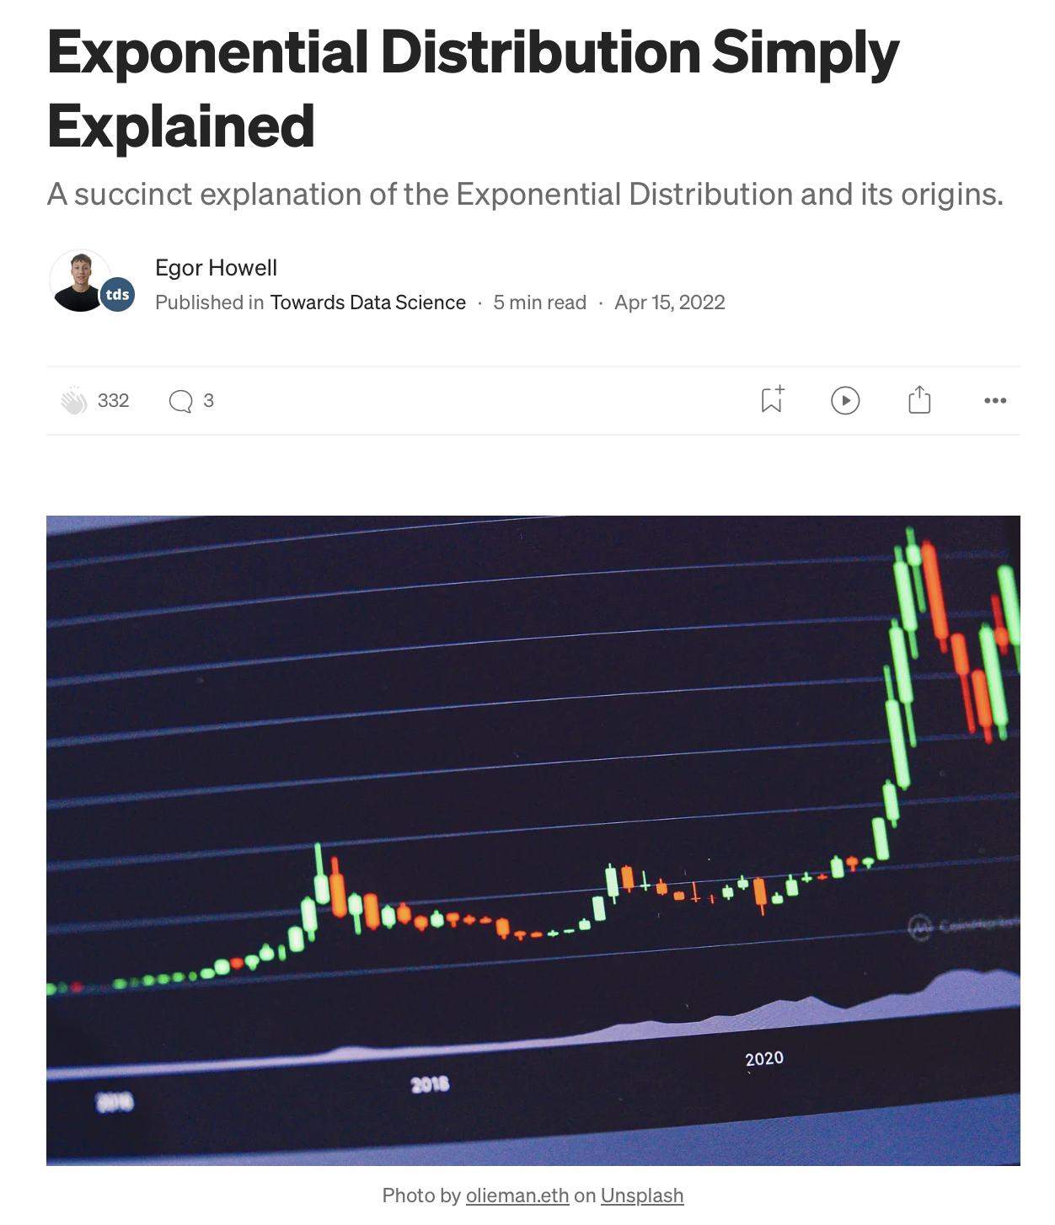



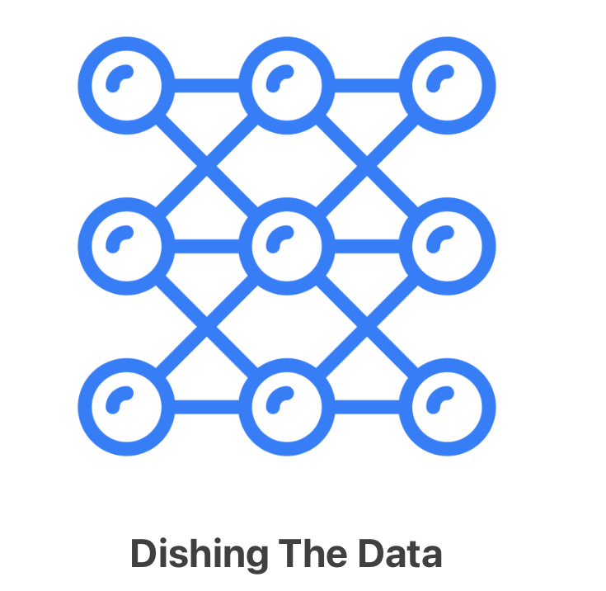
Thanks
@egorhowell
Newsletter

